Slide 1
White Papers: The Most Effective Fundraising Tool
James M. Langley
President , Langley Innovations
November 30, 2021

Slide 2
White Papers
What are they?
A 4 or 5-page draft describing an initiative that’s still “on the drawing board”
An invitation to co-creation
A credible conversation starter, high content, low gloss
Used to test the alignment between your competencies (that you want to amplify) and donors’ strongest philanthropic convictions

Slide 3
White Papers
Why is it the most effective fundraising tool?
Because successful solicitations stem from progressive dialogue
7-9 interactions
Donors increasingly self-directed, designating gifts
Giving through to generate societal impact not just giving to for the sake of subsidizing basic operations

Slide 4
42,000,000: People who are interested in donating to charitable causes (in general)
40,000,000: People in households that donate money to political causes
26,000,000: People who are interested in donating to veteran causes
19,400,000: People in households that donate money to health causes
10,200,000: People in households that donate money to environmental or wildlife causes
9,800,000: People in households that donate money to animal welfare
5,600,000: People who have an interest in making donations to cancer causes
5,000,000: People who have an interest in making donations to children's causes
4,000,000: People who are interested in donating to religious causes
1,800,000: People who are interested in donating to world relief causes
960,000: People in households that donate money to arts or cultural causes

Slide 5
White Papers
If fewer people are giving to institutions and more to causes, doesn’t it stand to reason that institutions need to act more likely causes if they hope to raise more and stem the loss of donors?
Lift the sights of current donors
Cause-orientation is the key to younger generational giving

Slide 6
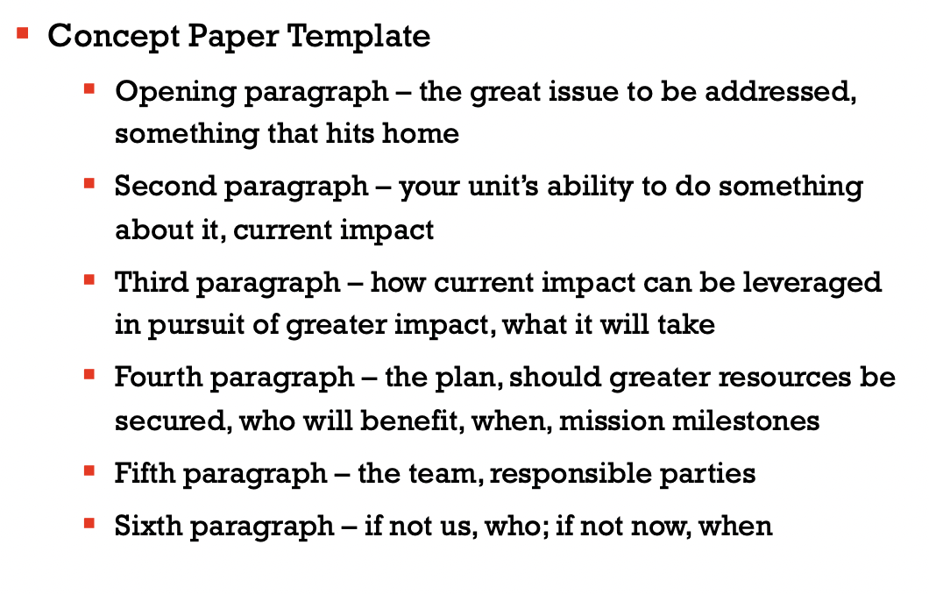
White Papers

Slide 7
White Papers
Let facts speak for themselves
Use as few adjectives and superlatives as possible
Avoid over-statement and overreach
Don’t dress up the document
High content, low gloss

Slide 8
White Papers
How we use them
Test alignment – try them on donors who have a strong probability of resonating with the proposed initiative
Previous giving
Advocacy
Hits home

Slide 9
White Papers
Vetting
1:1 sessions
Focus groups
Salon events
Online postings (Dickinson)

Slide 10
White Papers
Series of 1:1 sessions is most effective, can assess degrees of interest, potential ownership, customize for major donors
The more time, energy and talent donors contribute to the formation of the idea, the more likely they are to fund it
Moving from dialogic to experiential will accelerate and deepen their interests
Create conditions that allow them to sell themselves

Slide 11
White Papers
Important to reflect what you have learned from the vetting process and from individuals
Incorporate as much as you can, be honest about what you can’t
A return to the formative stages of democratic philanthropy
We the people creating more perfect organizations and community

Slide 12
White Papers
Photo by Ian C. McLennan
Thank you
Questions

