Slide 1
Thriving Fine Arts Enrollments in the New Higher Education Ecology
Jay Goff
Vice President for Enrollment
and Retention Management
Sheena Ramirez
Director of Recruitment
College of Visual and Performing Arts
Scott Cline, Ed.D.
Vice President of
Enrollment Management
Seattle 2018
55th Annual Conference of ICFAD

Slide 2
What is Strategic Enrollment Management (SEM)?
Strategic enrollment management is a concept and process that enables the fulfillment of institutional mission and students’ educational goals.
Research
Recruitment Retention
Seattle 2018
55th Annual Conference of ICFAD

Slide 3
Research
Jay Goff
Vice President for Enrollment
and Retention Management
Seattle 2018
55th Annual Conference of ICFAD

Slide 4
SEM is about Student Success
Working to have the entire college/university community active in, and responsible for, recruiting, retaining and graduating students.
SEM Research
Market Trends and Influences on SEM Planning: SLU Sample
Application of Research: Personalized Engagement
Seattle 2018
55th Annual Conference of ICFAD

Slide 5
SEM is Moving Beyond the Fundamentals
The Classic Admissions Funnel
Factors Most Noted in
College Selection Process
Majors & Career Programs Offered
Location/Campus Characteristics
Cost/Affordability
Campus Size/Safety
Characteristics of Enrolled Students
Selectivity
Prospects
Inquiries
Applicants
Admits
Enrollees
Seattle 2018
55th Annual Conference of ICFAD

Slide 6
Core Enrollment Management Principles
No Enrollment Effort is Successful without QUALITY Academic Programs
Recruitment and Retention is an On-going, Multi-year PROCESS with Strong Access to Research and DATA
Majority of Enrollments come from REGIONAL Student Markets
The Most Successful Recruitment Programs Clearly DIFFERENTIATE the Student Experience from Competitor’s Programs
The Most Successful Retention Programs Clearly Address Students’ Needs and Regularly ENGAGE Students in Academic and Non-Academic Programs
Seattle 2018
55th Annual Conference of ICFAD
SOURCE: Goff, 2005

Slide 7
Core SEM Research
Primary and Secondary Markets: “Golden Circle”
Student and Workforce Demand
Competitor Analysis
Enrollment Funnel and Yield Rates
Program Retention and Graduation Rates
Student Satisfaction and Placement Outcomes
Seattle 2018
55th Annual Conference of ICFAD

Slide 8
National Degree Demand from the 800,000 Qualified College Bound Students
Seattle 2018
55th Annual Conference of ICFAD

Slide 9
Less Interest in Humanities and Business
SOURCE: https://www.the-american-interest.com/2017/05/03/todays-college-freshmen-are/
Seattle 2018
55th Annual Conference of ICFAD

Slide 10
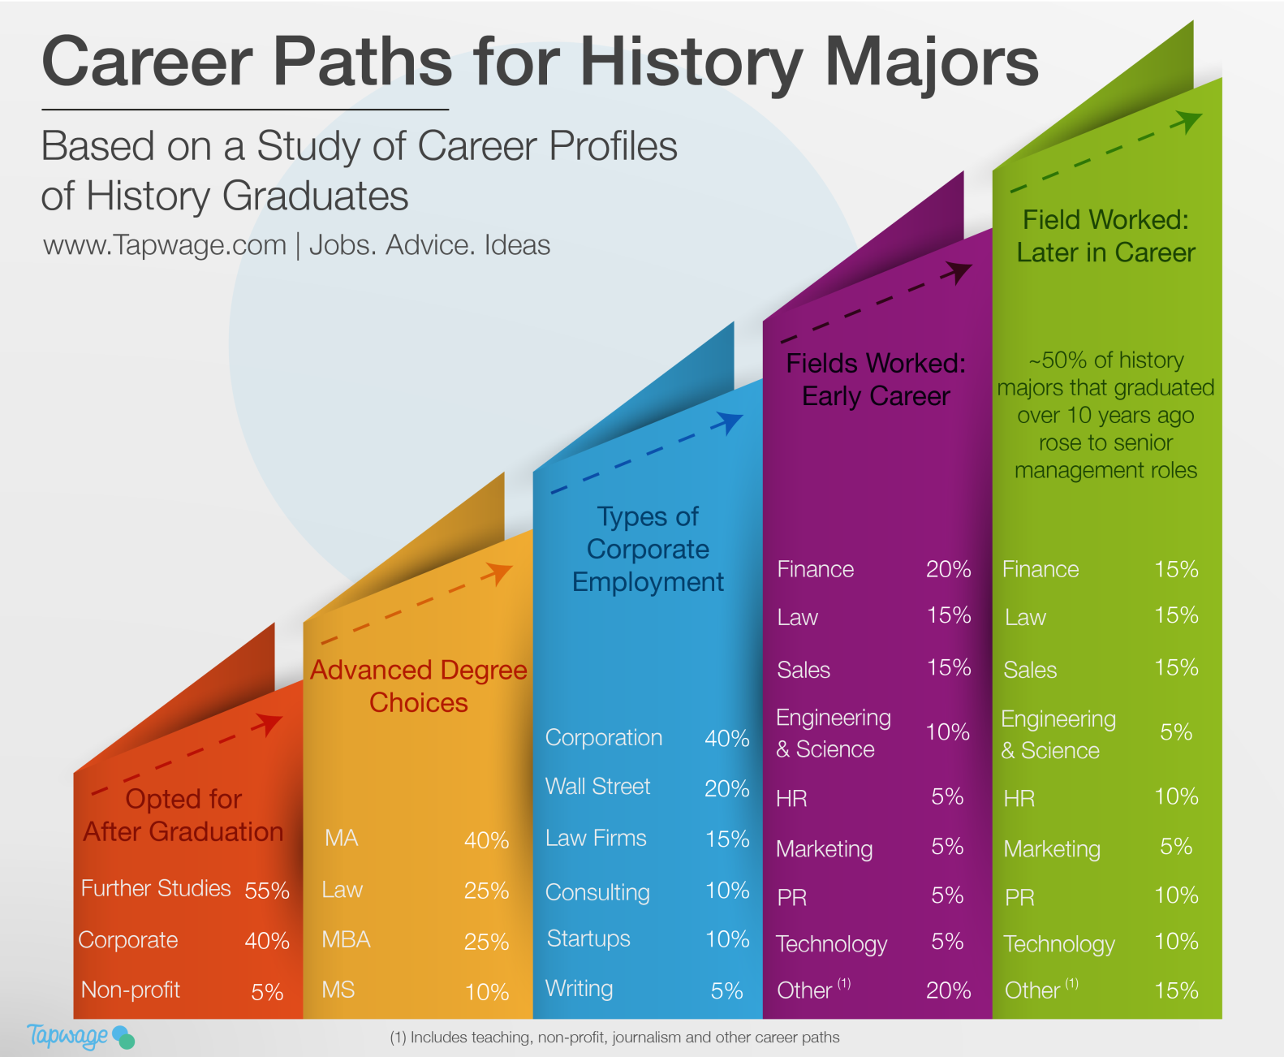
The Decline in Humanities Majors
Seattle 2018
55th Annual Conference of ICFAD
SOURCE: https://mlaresearch.mla.hcommons.org/2017/06/26/the-decline-in-humanities-majors/

Slide 11
Case Study
Seattle 2018
#casfaa2018
55th Annual Conference of ICFAD

Slide 12
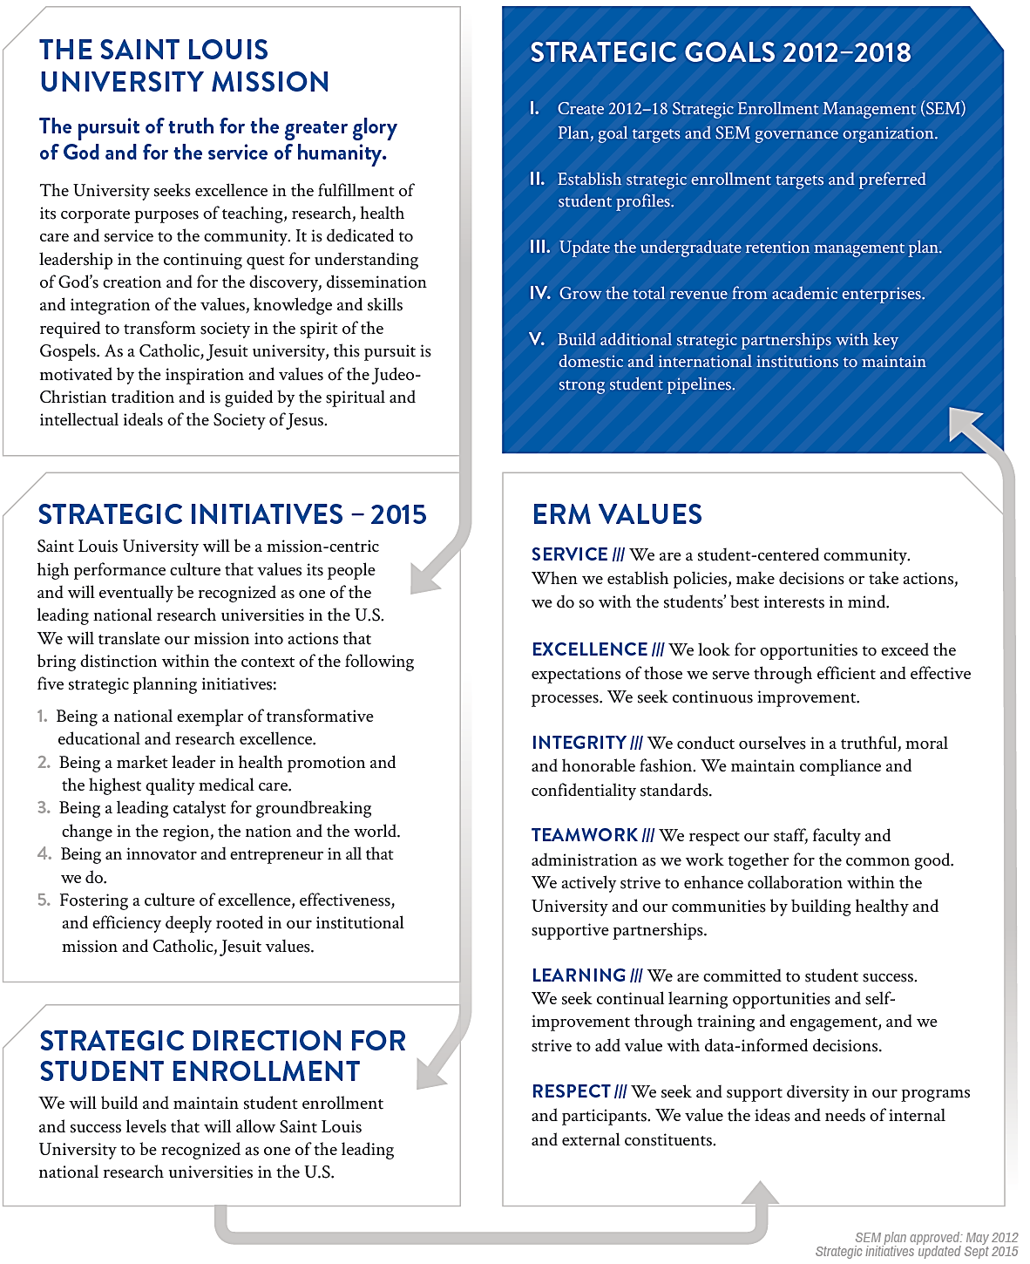
2012 – 18 |
Strategic Enrollment Management (SEM) Plan
Guiding Philosophy and Strategic Planning Framework
Seattle 2018
55th Annual Conference of ICFAD

Slide 13
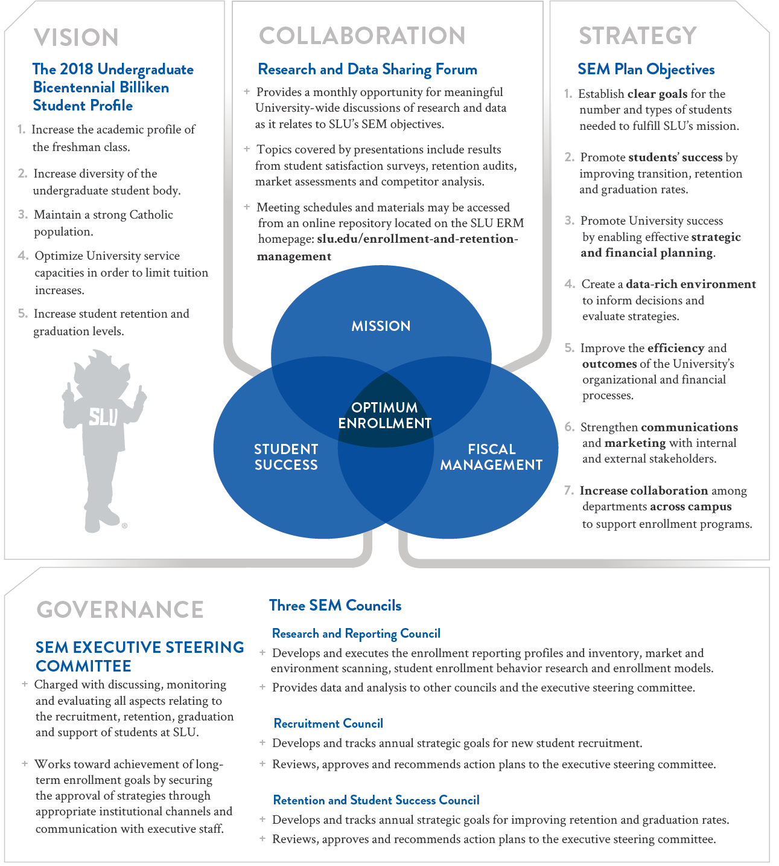
2012 – 18 |
Strategic Enrollment Management (SEM) Plan
Embracing Best Practices for Student Enrollment and Success at a National Research University
Seattle 2018
55th Annual Conference of ICFAD

Slide 14
Personalized & Interactive Outreach
New Visit Center
Interactive Globe
SLU PEP – Personalized Experience Portfolio
https://customviewbook.slu.edu/wizard
Virtual Tour Link
https://www.slu.edu/about/st-louis/tours/virtual_tour.php
Seattle 2018
55th Annual Conference of ICFAD

Slide 15
SLU PEP: Personalized Experience Portfolio
Seattle 2018
55th Annual Conference of ICFAD

Slide 16
SLU PEP: Personalized Experience Portfolio
Seattle 2018
55th Annual Conference of ICFAD

Slide 17
Recruitment
Sheena Ramirez
Director of Recruitment
College of Visual and Performing Arts
Seattle 2018
55th Annual Conference of ICFAD

Slide 18
Changing Environment in Arts Recruitment
Millennials vs. “Homeland” generation
Baby Boomers vs. Generation Xers
Post 2008 financial uncertainty
Attitude changes about arts degrees
ROI, double majors, innovation, jobs
Seattle 2018
55th Annual Conference of ICFAD

Slide 19
Assessing the Needs of these Students and Parents
Homeland students and their Generation X parents care about:
Outcomes
Peer Opinions
Privacy
Lived Experiences
Individual attention
Engagement
Visual Stimulation
Affordability
Seattle 2018
55th Annual Conference of ICFAD

Slide 20
Ways to Adapt your Current Model of Recruitment to Meet Student Needs
Peer to Peer: find more ways to connect current students with prospective students, such as phone campaigns, social media, and on-campus events.
Faculty engagement: offer more opportunities for students to sit in on classes, with online registration options the whole year out.
Yield event: make sure that your arts programs offer a unique visit during this crucial time frame, different than your audition/portfolio review days.
Technology: personalization in your communication plans, connecting prospective students with faculty and current students, and offering in depth, deep-dive clickable information on your website.
Boots on the ground: send faculty and arts specific recruitment staff into classrooms in your up and coming feeder high schools.
Seattle 2018
55th Annual Conference of ICFAD

Slide 21
Case Study
Seattle 2018
#casfaa2018
55th Annual Conference of ICFAD

Slide 22
James Madison University and the College of Visual and Performing Arts
Implemented Recruitment Techniques from 2015-2018
High School Visits (between 40-45 annually by CVPA Staff)
Technology: Hobsons CRM (events, deadline reminders, personalized faculty letters, data entry into the Admissions CRM)
Yield Strategy
Social Media – Twitter Takeovers, CVPA Student Ambassador Instagram account
Peer to peer – personalized mail merged emails from Ambassadors to admitted students, phone call follow up
CHOICES+: JMU Artists’ Celebration
Faculty/student dinner, student shadowing, hosted on-campus
2016 (70 of 80 matriculated), 2017 (51 of 67 matriculated), 2018 (78 of 93 matriculated)
Seattle 2018
#casfaa2018
55th Annual Conference of ICFAD

Slide 23
James Madison University and the College of Visual and Performing Arts Enrollment Numbers 2013 - 2018
Seattle 2018
55th Annual Conference of ICFAD

Slide 24
Retention
Scott Cline, Ed.D.
Vice President of Enrollment Management
Seattle 2018
55th Annual Conference of ICFAD

Slide 25
For every student you retain
=
One less new student you need to enroll
Seattle 2018
#casfaa2018
55th Annual Conference of ICFAD

Slide 26
Reason for:
Moral & Ethical Imperative
Accountability (state, federal, institutional)
Cost & Money
A single undergraduate:
private institutions | $2,357
public institutions | $536
2018 Cost of Recruiting an Undergraduate Student Report, Ruffalo Noel Levitz (http://learn.ruffalonl.com/rs/395-EOG-977/images/RNL_2018_Cost_of_Recruiting_Report_EM-005.pdf)
Seattle 2018
#casfaa2018
55th Annual Conference of ICFAD

Slide 27
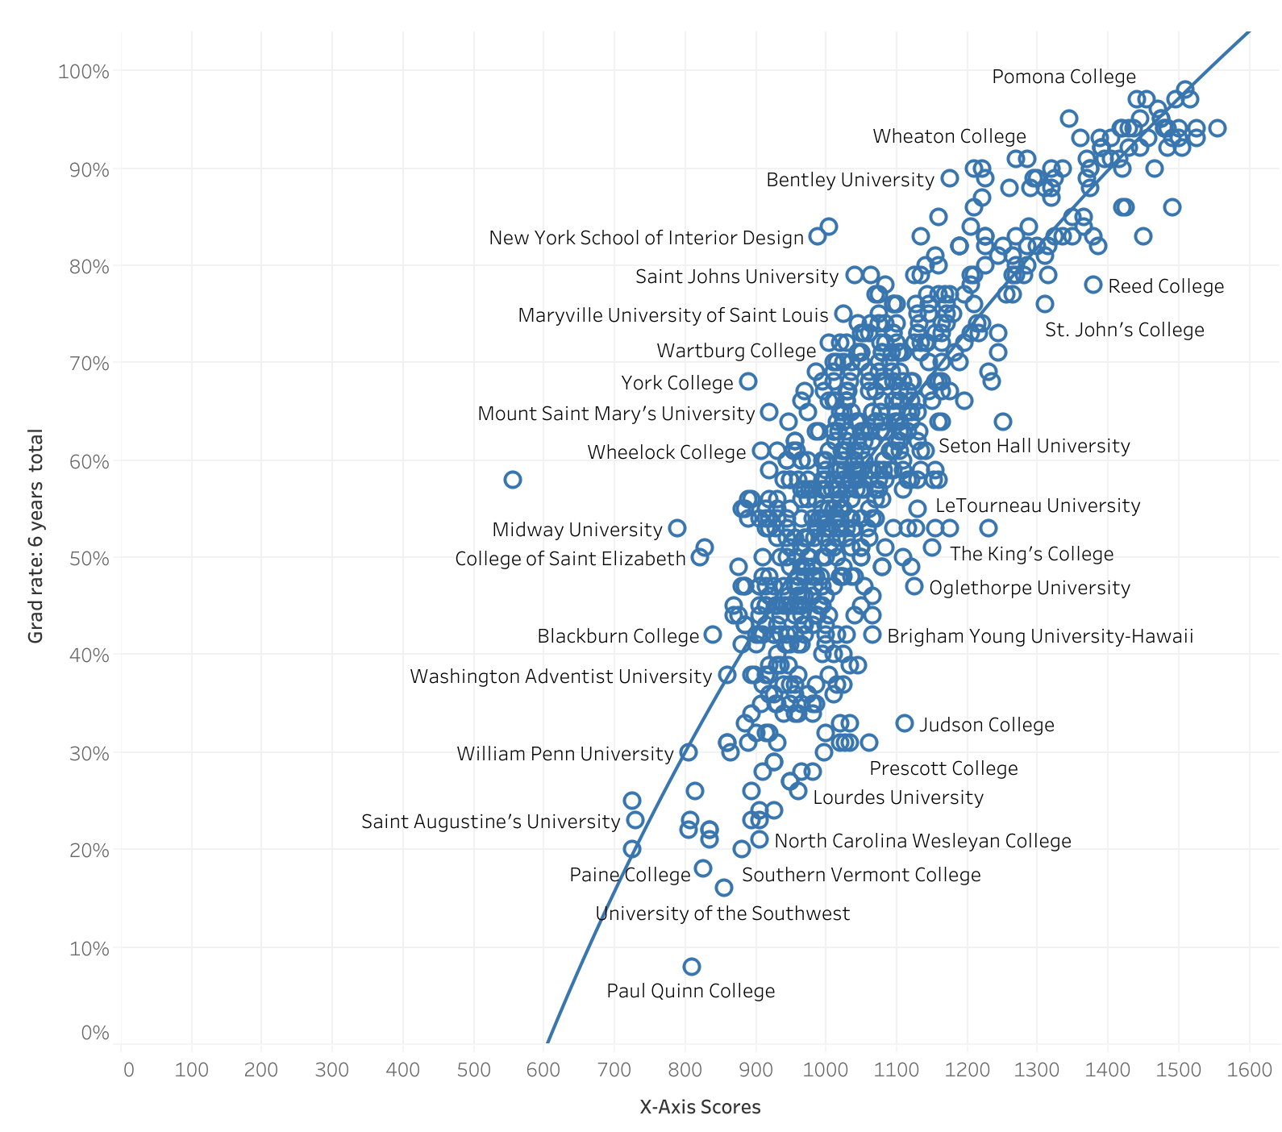
Historically
Input = Outputs
Predictors =
GPA
SAT
Pell Grant %
.An Interactive Retention Visualization (https://highereddatastories.blogspot.com/2018/08/an-interactive-retention-visualization.html)
Seattle 2018
#casfaa2018
55th Annual Conference of ICFAD

Slide 28
Strategies
Identify the stakeholders
Set the goals
Understand the data & landscape
Low Hanging Fruit
Hardest Cases
“Murky Middle” - EAB
The "Murky Middle" (https://www.eab.com/technology/student-success-collaborative/members/infographics/murky-middle)
Seattle 2018
#casfaa2018
55th Annual Conference of ICFAD

Slide 29
Case Study
Seattle 2018
#casfaa2018
55th Annual Conference of ICFAD

Slide 30
California College of the Arts
Retention Committee
Data Sharing and Communication
Stakeholders for Shared Goals & Ownership
Strategic Investments
First-year work/study program
Small balance waiver & micro-scholarship program
Unified campus and student housing
Seattle 2018
#casfaa2018
55th Annual Conference of ICFAD

Slide 31
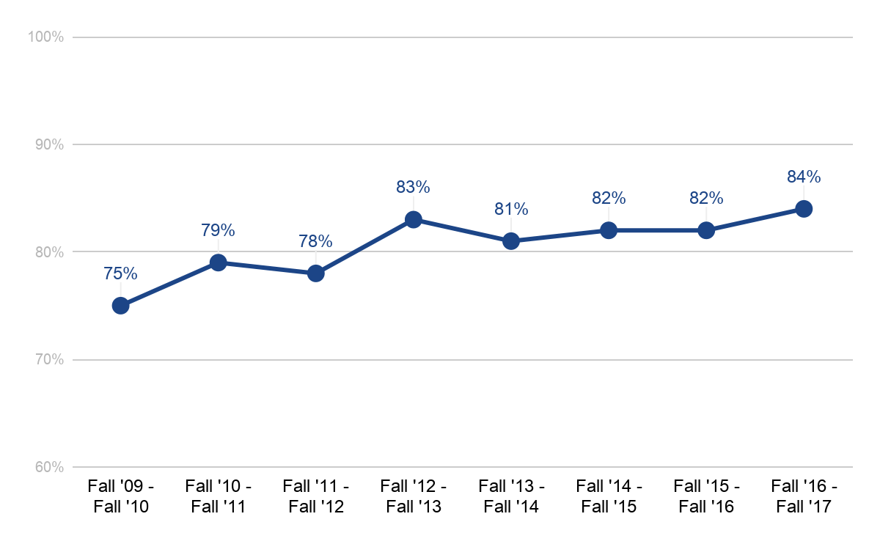
First-Year Retention Rates
Seattle 2018
#casfaa2018
55th Annual Conference of ICFAD

Slide 32
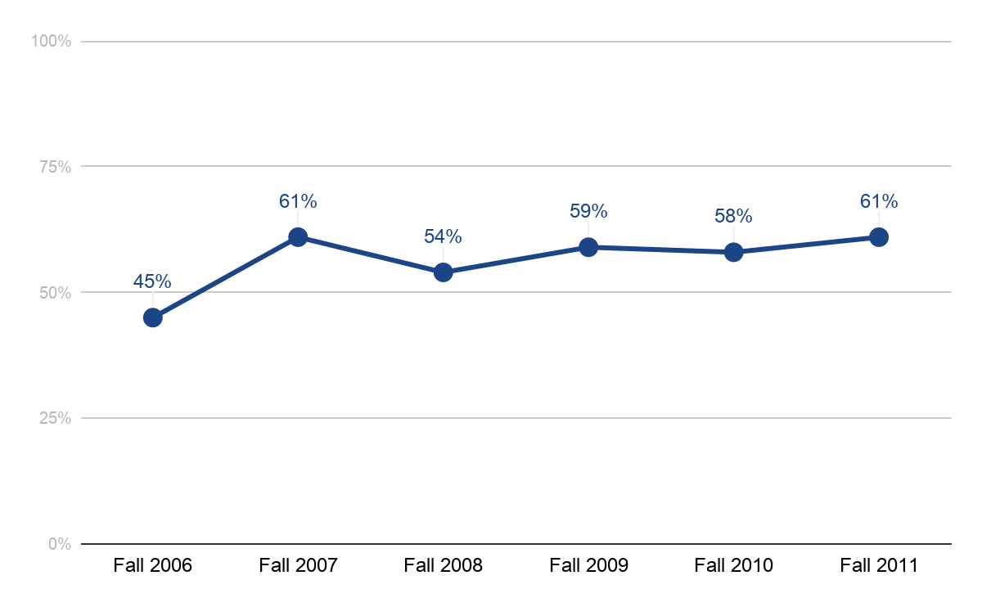
Six-Year Graduation Rates
Seattle 2018
#casfaa2018
55th Annual Conference of ICFAD

Slide 33
Questions & Discussion
Seattle 2018
#casfaa2018
55th Annual Conference of ICFAD

